Slide 1
CRM Data Science Road Map
Jassim Moideen

Slide 2
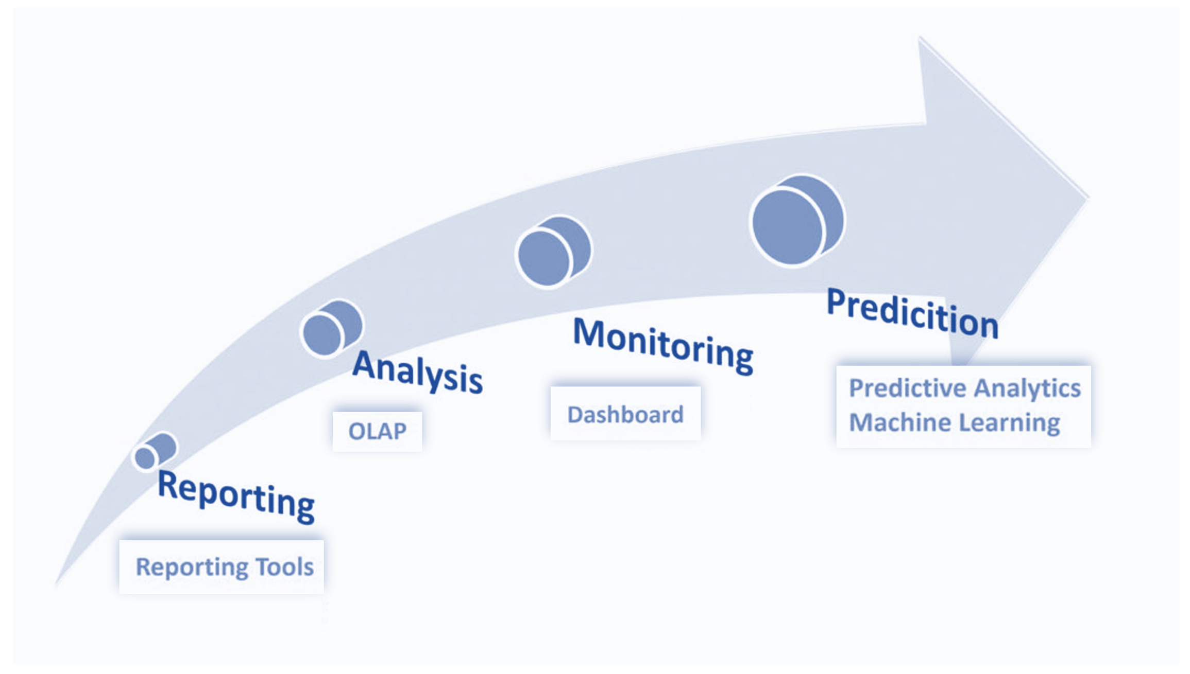
Evaluate our current state of analytics capability ?

Slide 3
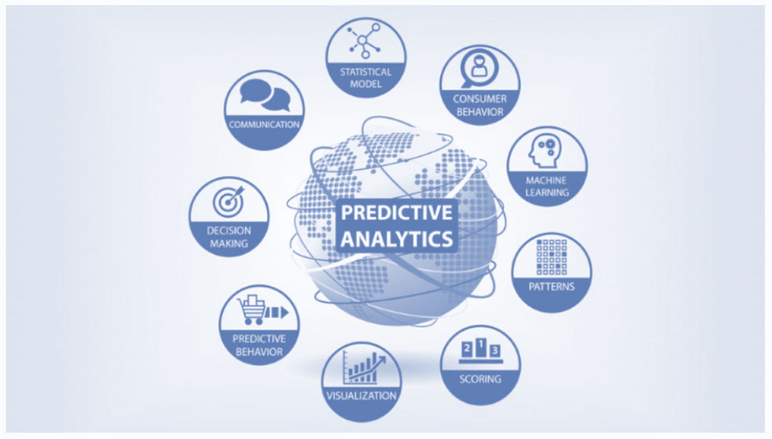
What constitutes as Predictive Analytics ?

Slide 4
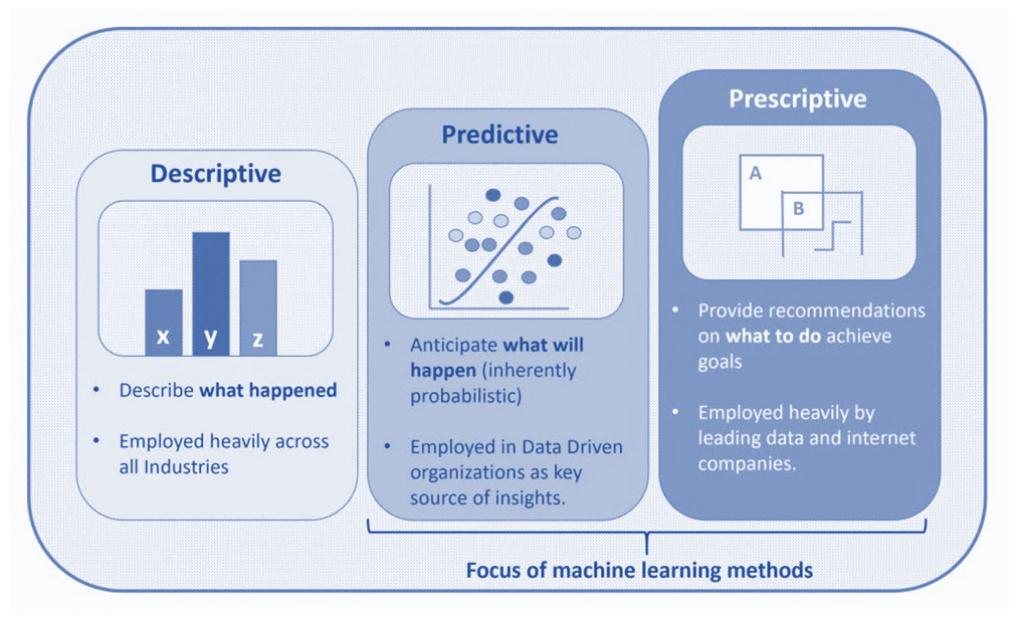
Focus and drive towards moving into the Prescriptive Analytics space.

Slide 5
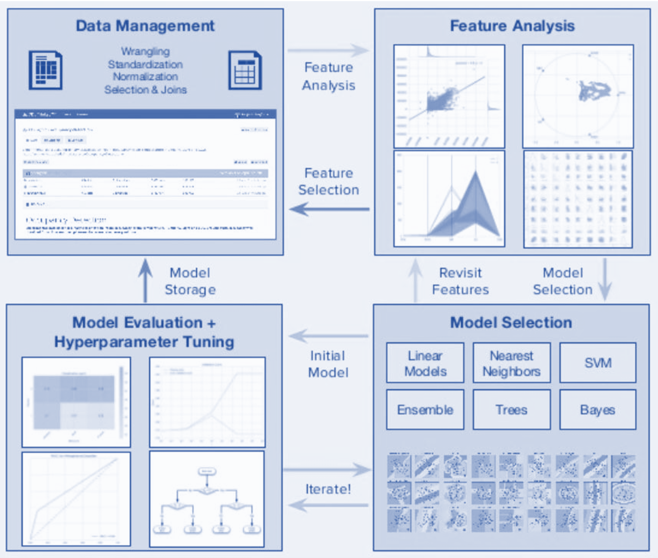
Standardise the 4 phases of the Machine Learning workflow process
These 4 phases can be further explored as individual areas with standard subfunctions.

Slide 6
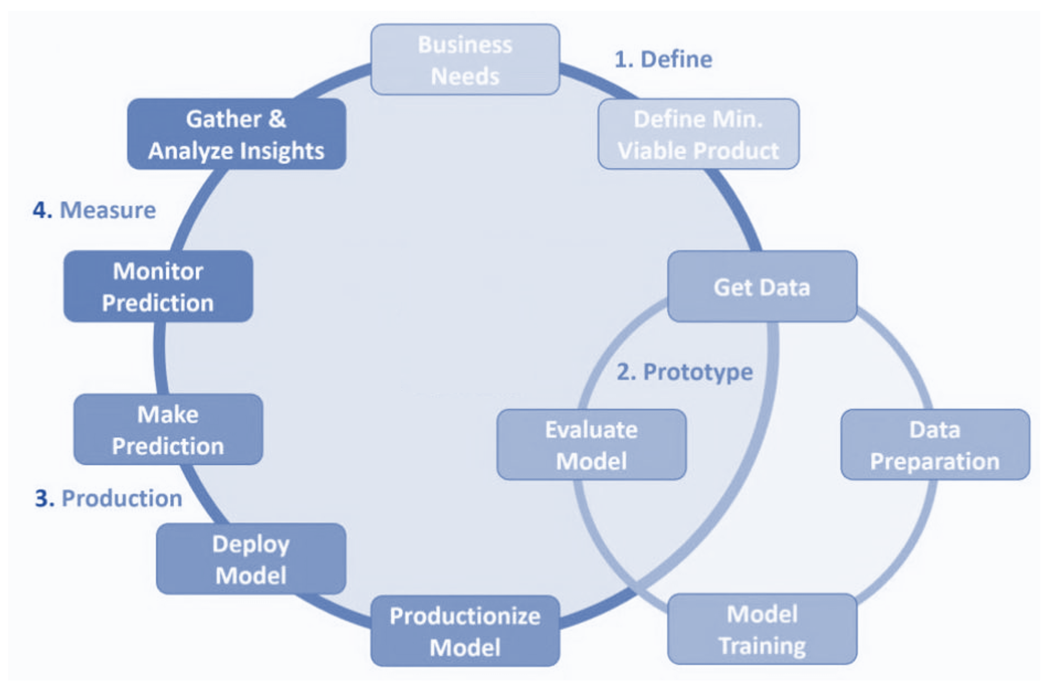
Update from traditional DWH & BI CRISP lifecycle to a ML based workflow

Slide 7
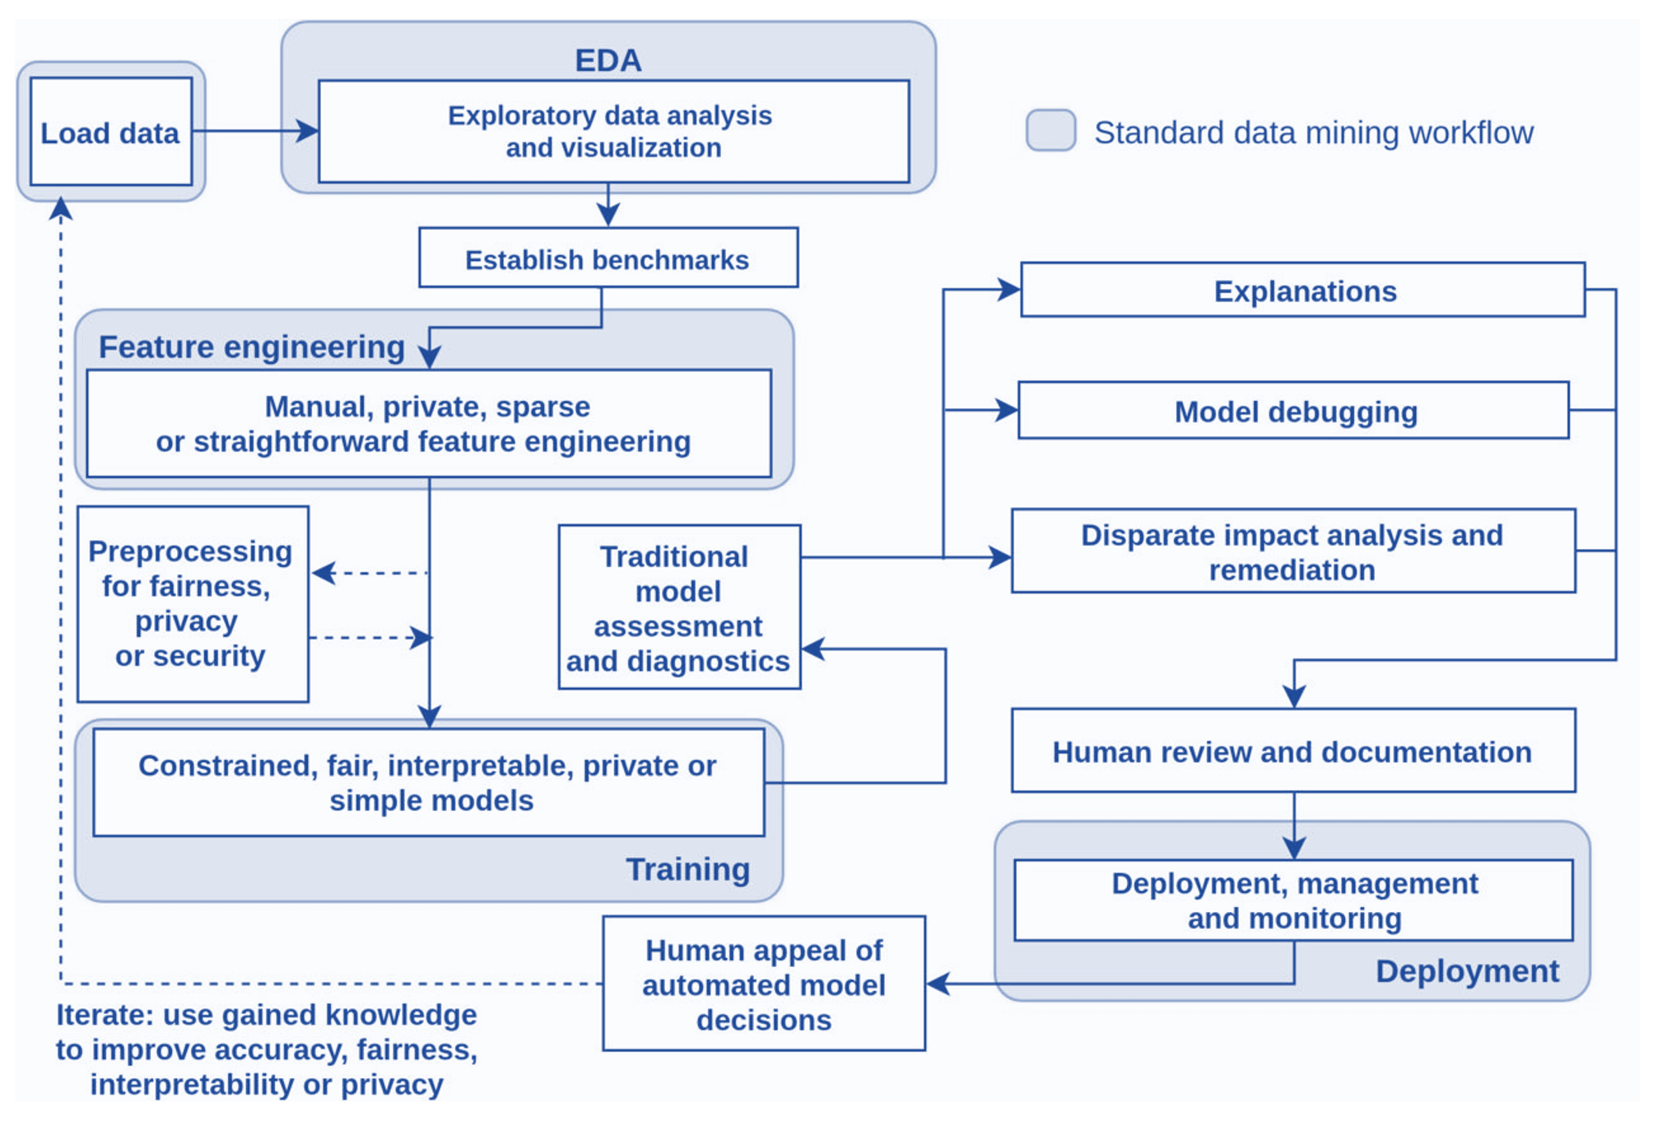
Follow all the steps in the Machine Learning workflow subprocesses

Slide 8
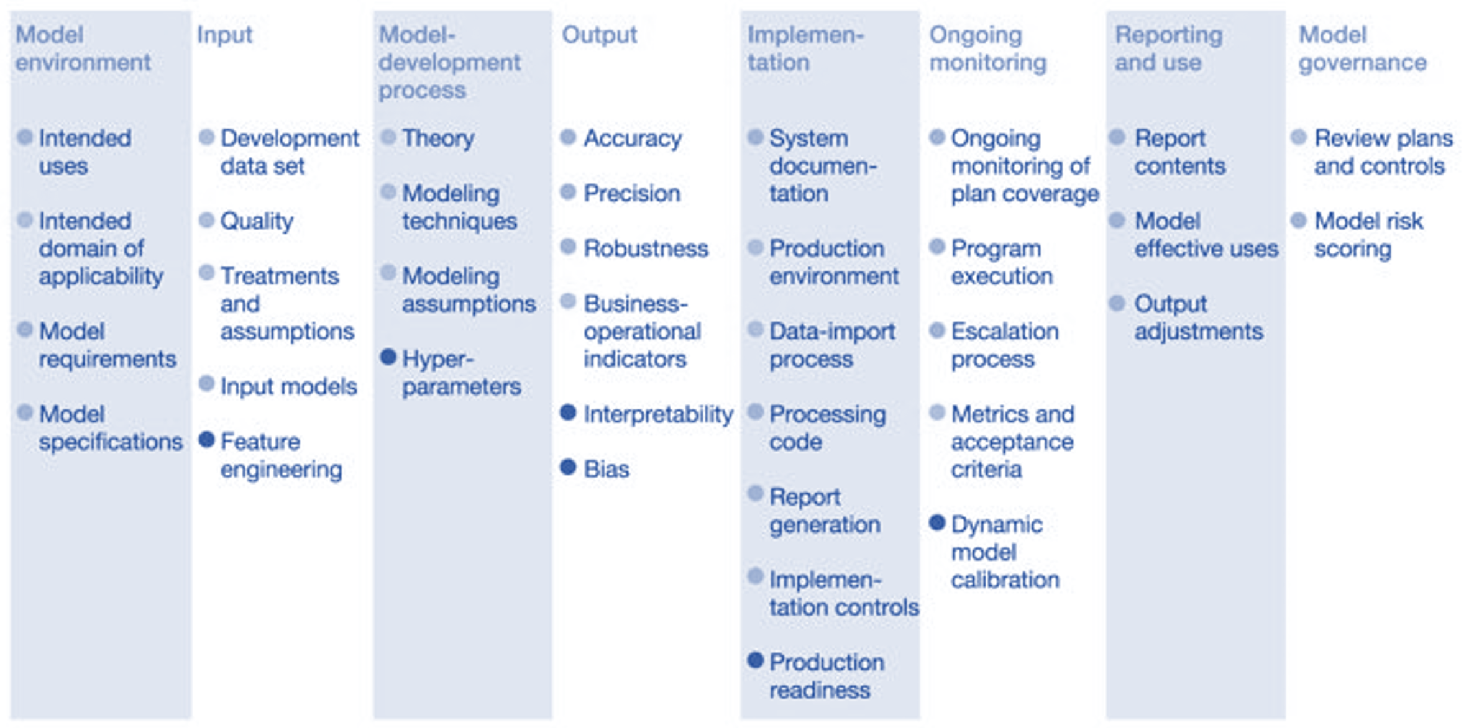
Establish a staggered end to end data science practice for delivery

Slide 9
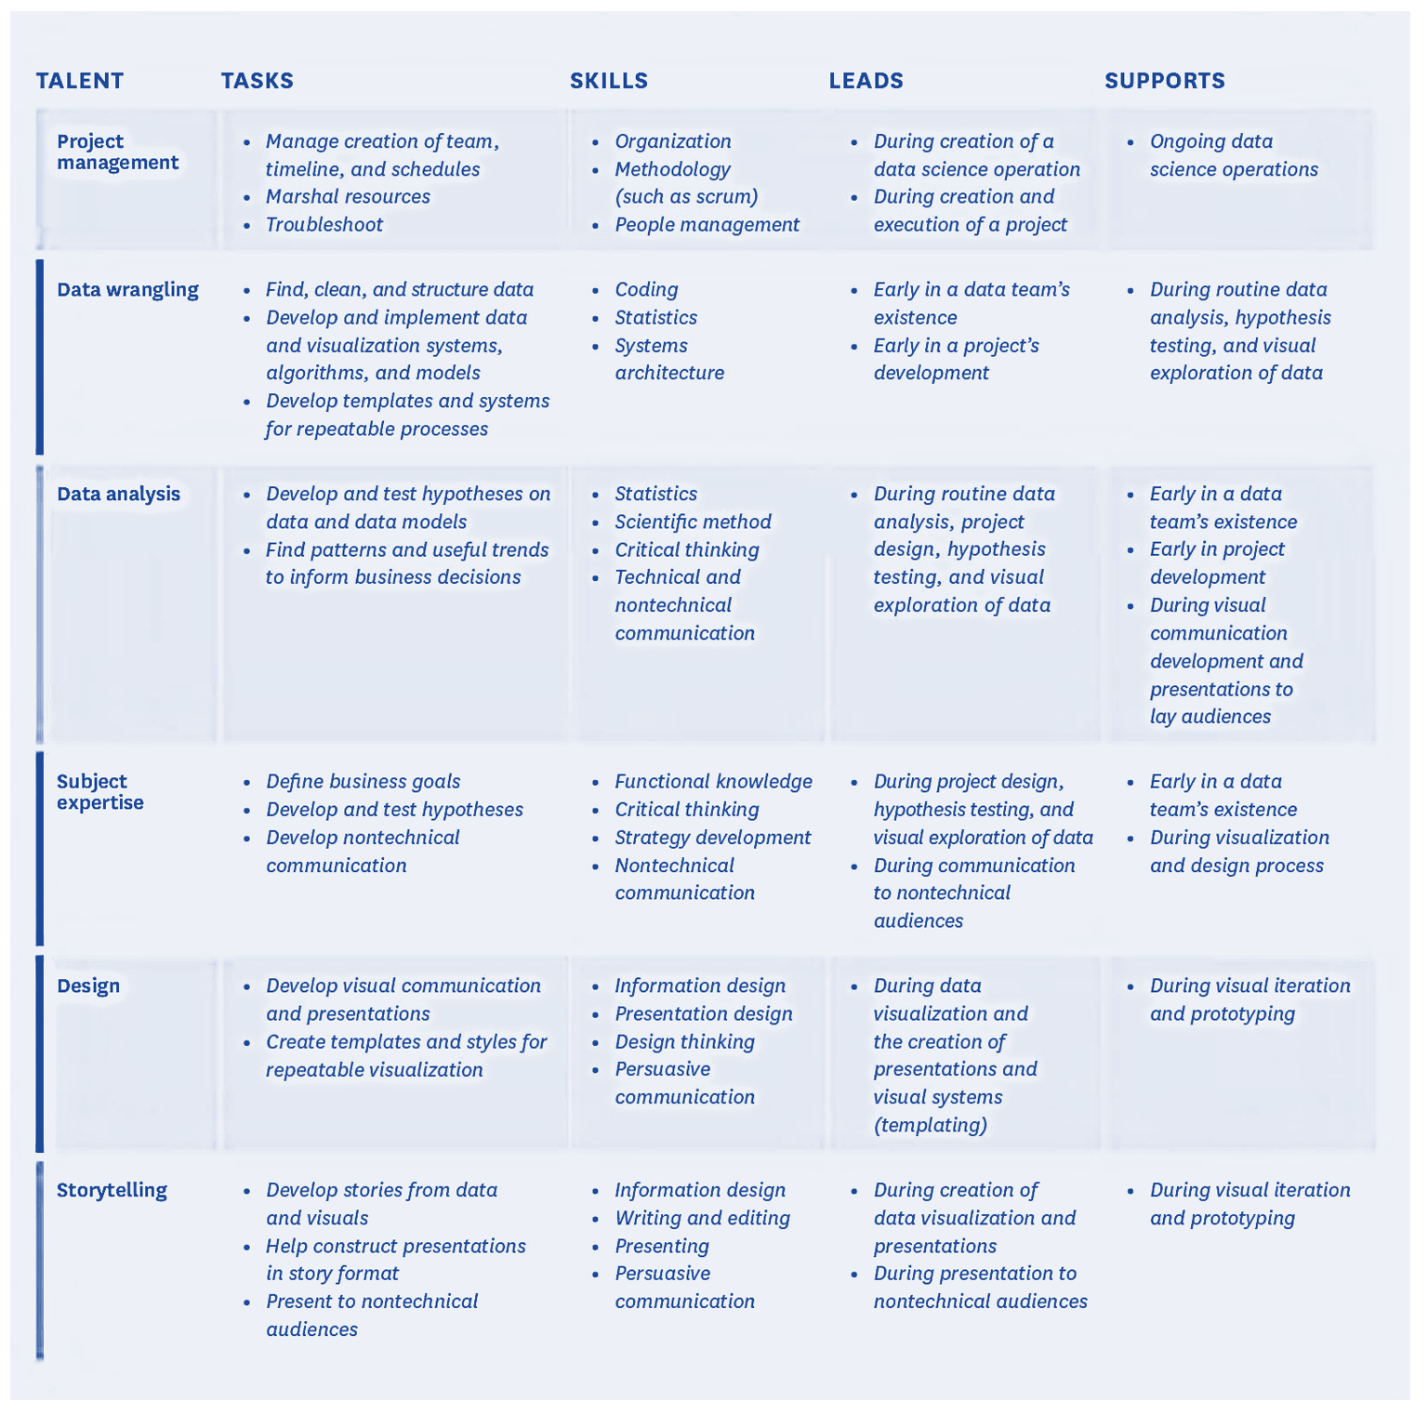
Ideal Data Science Team Composition – Functional Capabilities

